Slide 1

Archaeological sites in Bangladesh

Slide 2
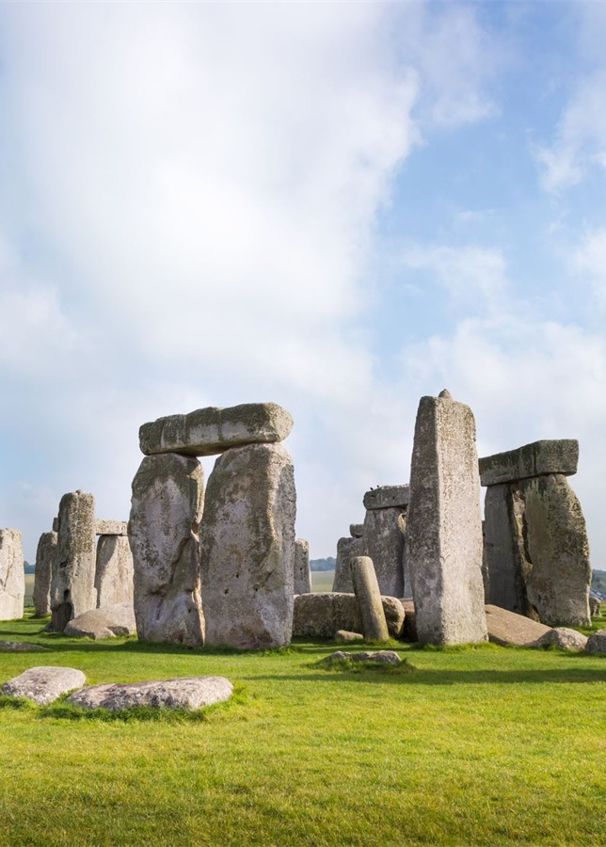
What is Archaeology
Archaeology is fundamentally the study of humanity and its past. Archaeologists study things that were created, used, or changed by humans. They do this by looking at the material remains that we leave behind, such as stone tools, gold jewelry, or pyramids.
“Archaeology is the study of the ancient and recent human past through material remains. Archaeologists might study the million-year-old remains of our earliest human dynasties in Africa. Or they might study 20th-century buildings in present-day New York City. Archaeology analyzes the physical remains of the past in search of a broad and comprehensive understanding of human culture”.
-Society for American Archaeology

Slide 3
Types of Archaeology
Archaeology is a diverse field of study. Most archaeologists focus on a particular region of the world or a specific topic of study. Specialization allows an archaeologist to develop expertise on a particular issue.
Some archaeologists study human remains (bioarchaeology),
Animals (zooarchaeology),
Ancient plants, stone tools, etc.
Some archaeologists specialize in technologies that find, map, or analyze archaeological sites. Underwater archaeologists study the remains of human activity that story below the surface of water or on coasts.
Around the world, archaeological methods are similar. In other parts of the world, archaeology is an independent field of study or part of historical research.

Slide 4

The significance of Archaeological Sites
Identity and belonging
Historical perspective
Tourism and economic growth
Cultural diversity
Documentation
Education and awareness
Legal protection
International cooperation

Slide 5
Challenges to the preservation of Archaeological Sites
Urbanization
Climate change
Conflict and war
Lack of funding, resources

Slide 6
Archaeological Sites of Bangladesh
Bangladesh is a country considerably rich in archaeological wealth, especially of the medieval period, both during the Muslim and pre-Muslim rules, though most of it is still unexplored and unknown. In archaeological fieldwork and research, this area was very much neglected for a long time for various reasons, not the least of which are its difficult geography and climate, and remoteness from the main centers of the subcontinent.
With the independence of Bangladesh in 1971, the Government has undertaken a number of field projects, including a comprehensive survey and exploration of the previously unexplored areas.
Though work at present is carried out on a limited scale, the discoveries already made have been significant, while new information and fresh evidence are coming out gradually. These fresh explorations are likely to add substantially to our knowledge of the history and chronology of ancient Bangladesh and various aspects of its life and culture.
The earlier history of Bangladesh exposes that Buddhism received royal patronage from some important ruling dynasties like the great Pala rulers, the Chandras, and the Deva Kings. Under their royal patronage, numerous well-organized, self-contained religious foundations sprang up all over the country.

Slide 7
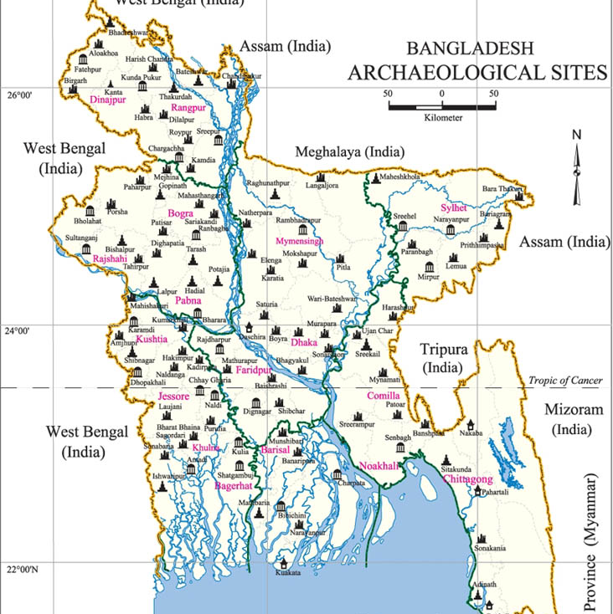

Slide 8
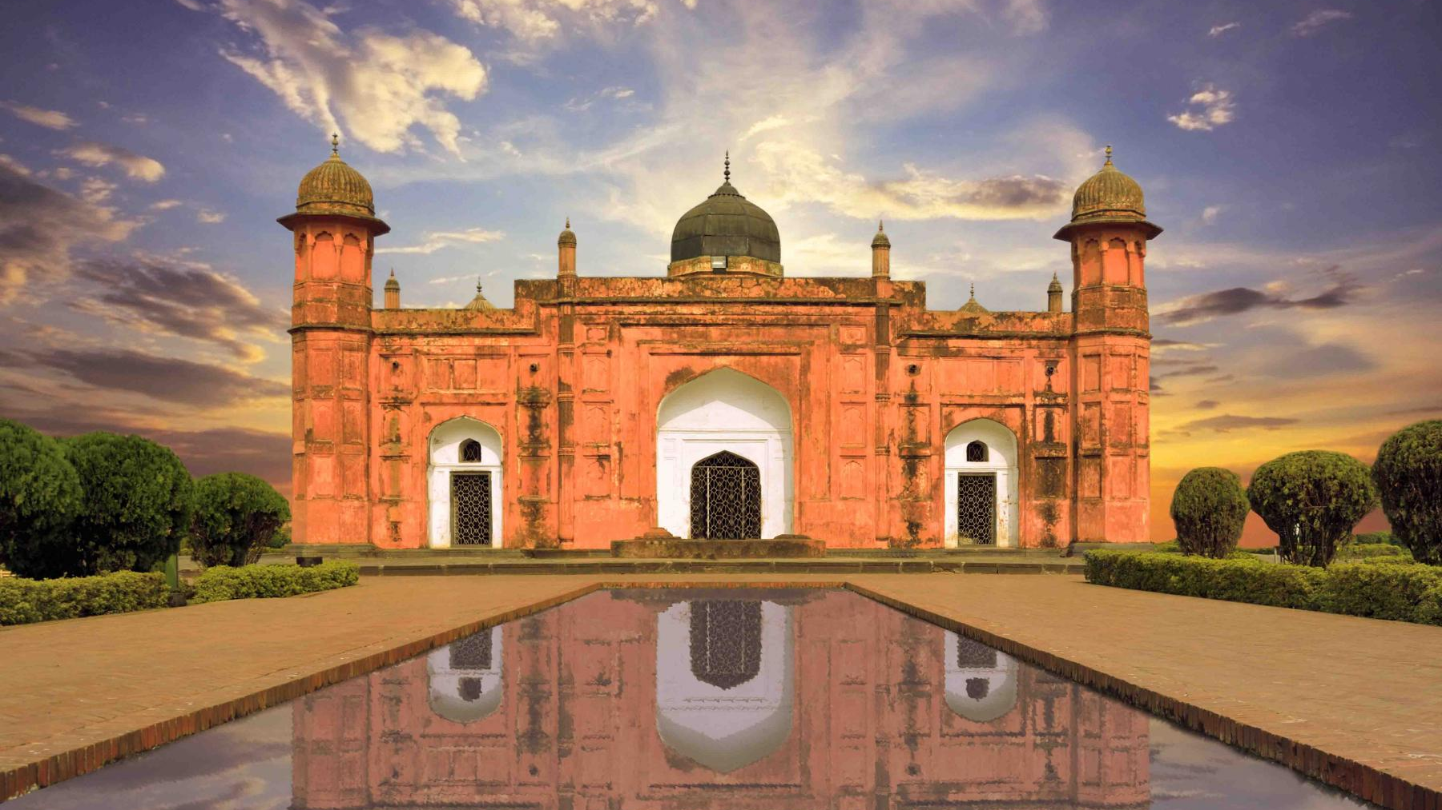

Slide 9

Lalbagh Fort
One of the finest cases of the Mughal period is the Aurangabad Fort, commonly known as Lalbagh Fort, which indeed represents the unfulfilled dream of a Mughal Prince. It occupies the south-western part of the old city, overlooking the Buriganga on the northern bank, and it stands as a silent watchman of the old city. Four-sided in plan, it encloses an area of 1082' by 800' and, in addition to corners and a subsidiary small natural gateway on the north, it also contains within its refreshed boundary several impressive monuments, surrounded by an attractive garden.
There is a small 3-round mosque, the grave of Bibi Pari, the reputed daughter of Nawab Shaista Khan, and the Audience Hall of the Governor. The main purpose of this fort was to provide a defensive enclosure for the lavish societies of the interior.

Slide 10
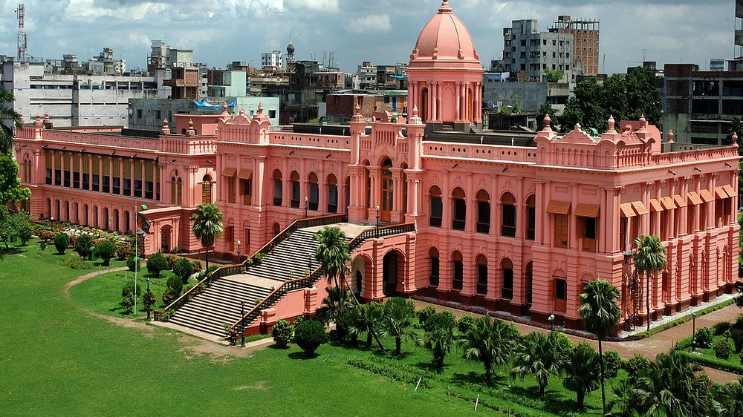

Slide 11
Ahsan Manjil (The Pink Palace)
Ahsan Manzil, situated at Kumartoli of Dhaka on the bank of the Buriganga was the residence and the kachari of the Nawabs of Dhaka. It has been turned into a museum recently. The construction of the palace was begun in 1859 and completed in 1872. Abdul Ghani named it Ahsan Manzil after his son Khwaja Ahsanullah. At that time the newly built palace was known as Rang Mahal and the earlier one was called Andar Mahal. Ahsan Manzil is one of the significant architectural monuments of the country.

Slide 12
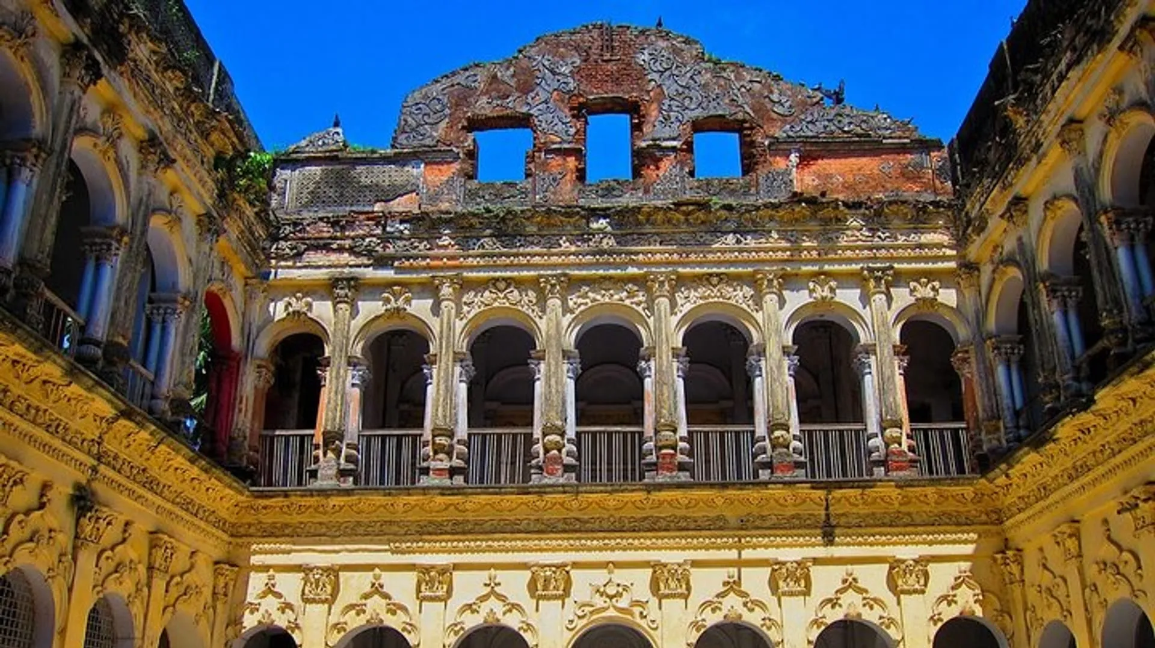

Slide 13
Sonargaon - the Old Capital of Bengal
The capital city of Sonargaon was situated on the northern bank of the Dhaleswari, close to the confluence of the Dhaleswari and the Sitalakshya, and also close to that of the Old Brahmaputra and the Meghna. The site of the city lies about 27 kilometers southeast of Dhaka city. The area now known as Panam in Sonargaon, about 2.5 kilometers to the north of the Dhaka-Chattogram highway.
Bangladesh Folk-Art Museum is situated in Sonargaon. It was established by Shilpacharya Zainul Abedin. It is open for tourists from Friday to Wednesday, from Morning 10-00 am to afternoon 5-00 pm.

Slide 14
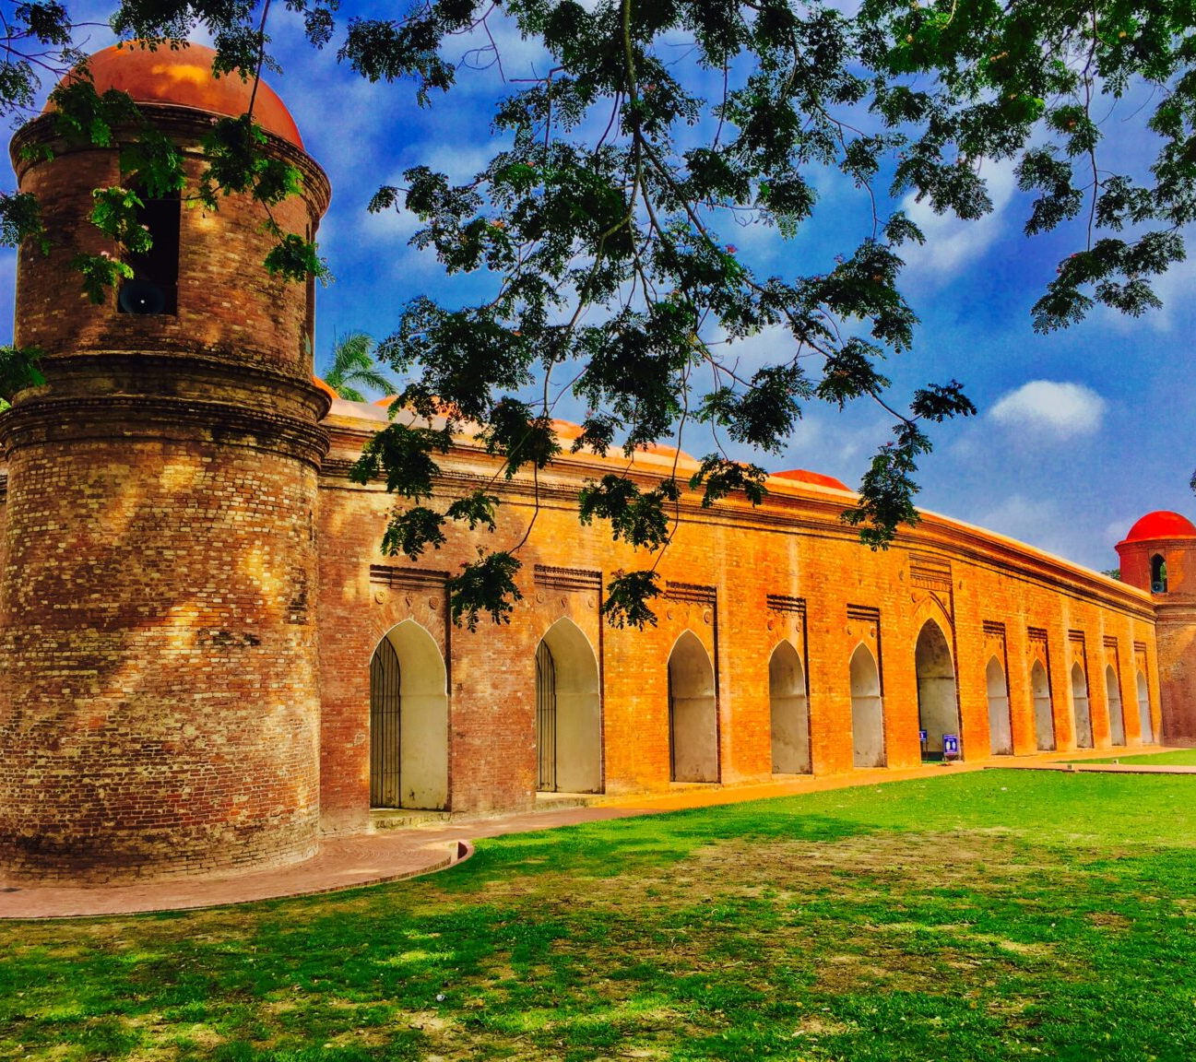
Shat Gambuj Mosque
Shait Gambuj Mosque, a UNESCO World Heritage Site, is a mosque in Bangladesh, the largest in that country from the Sultanate period. It has been described as "the most impressive Muslim monuments in the whole of the Indian subcontinent”. The mosque is locally known as the 'Shat Gombuj Masjid', which in Bangla means Sixty Domed Mosque. However, there are 77 domes over the main hall and exactly 60 stone pillars.

Slide 15
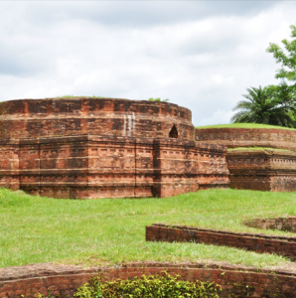
Mainamati
Mainamati once known as 'Samatata' denotes a land lying almost even with the sea-level. An isolated eleven-mile long division of textured low hill range known as the Mainamati – Lalmai range runs through the middle of Comilla district from north to south. It is the home of one of the most important Buddhist archaeological sites in the region. Comilla Cantonment is located nearby and houses a beautiful colonial era cemetery which houses the departed soldiers form World War II.
Mainamati is only 114 km. from Dhaka city and is just two-hour drive on the way to Chattogram.

Slide 16

Archaeological Significance:
Ruins of temples, and viharas
Artifacts dating from 7th-13th century AD
Potential site of historical capitals
The site has produced an impressive collection of archaeological finds, including:
Fossilized wood tools
Hindu and Buddhist monuments
Metallic coins
Terracotta inscriptions
Carved bricks
Ancient ornaments
Copper plates and seals

Slide 17
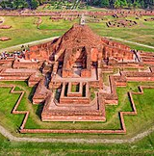
Paharpur Buddha Vihara
Paharpur - Badalgachhi Upazila, Naogaon District, Bangladesh (25°1'51.83"N, 88°58'37.15"E) is among the best-known Buddhist viharas in the Indian Subcontinent and is one of the most important archaeological sites in the country. It was designated a UNESCO World Heritage Site in 1985.
Key Features:
Officially known as Somapura Mahavihara
Located in a charming hill locality
Accessible via Jamalganj railway station
Nearest airport: Sayedpur

Slide 18
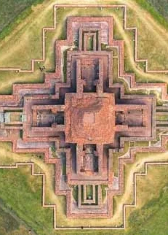
Mahasthangarh
Mahasthangarh is one of the earliest urban archaeological sites so far discovered in Bangladesh. The village Mahasthan in Shibganj thana of Bogra District contains the remains of an ancient city which was called Pundranagara in the territory of Pundravardhana. discovered in 1931, dates Mahasthangarh to at least the 3rd century BC. The fortified area was in use till the 18th century AD.

Slide 19
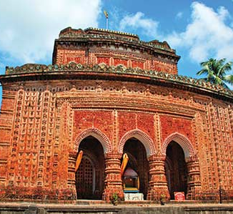
Kantajew Temple (Dinajpur)
This Temple near Dinajpur town was built in 1752 by Maharaja Pran Nath of Dinajpur. The temple, a 50' square three-storied society, rests on a slightly curved raised platform of sandstone blocks . It was originally a nava-ratna (Having 9 towers at the top) temple, crowned with four richly ornamental corner towers on two stores and a central one over the third store. Unfortunately, these ornate towers collapsed during an earthquake at the end of the 19th century.
Architectural Highlights:
Originally a Navaratna (nine-towered) temple
Extensively decorated surface
Elaborate divisions
Hindu classic narratives
Heavenly representations
Contemporary social life
Complex floral and geometric motifs

Slide 20
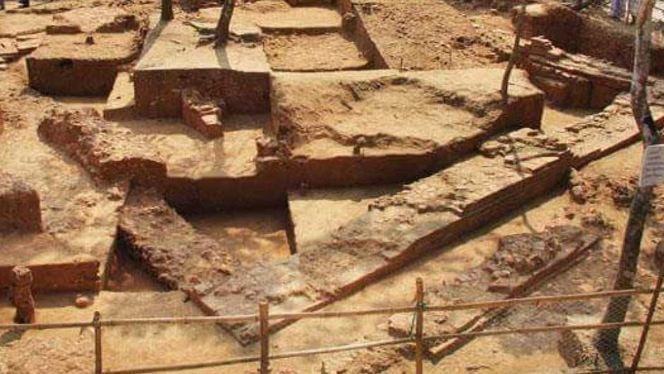

Slide 21
Wari-Bateshwar
Wari-Bateshwar is the site of an ancient city dating back to 450 BC situated in the north-eastern part of Bangladesh. This 2500-year old site is a significant archaeological discovery. It challenges the earlier notions about the existence of early urban civilization in Bangladesh.
The site is about 75 km from the capital Dhaka situated near the Wari and Bateshwar villages in the Belabo Upazila of Narsingdi District. It was discovered in the early 1930s by a local school teacher, Hanif Pathan. However, formal excavation started only recently in 2000. The current scientific study is being carried out by a team from the Archaeology Department of Jahangirnagar University.
The team believes that Wari-Bateshwar is the rich, well planned, ancient emporium (a commercial city) "Sounagora" mentioned by Greek geographer, astronomer, mathematician Ptolemy in his book Geographia.

Slide 22
References
https://en.banglapedia.org/index.php/Archaeology
https://central.mofa.gov.bd/en/site/page/Archaeological-Sites

